Slide 1


Social Development Bank Loans for 2019
Bashayr Alghamdi

Slide 2

Content
Resource
Question
Data
EDA
ML
Conclusion

Slide 3
Resource
Social Development Bank
https://www.sdb.gov.sa/en-us/default
KSA open data
https://data.gov.sa/Data/en/dataset/bank-loans-fo-2019

Slide 4

Question
What is the amount of loan the customer can get based on their data?

Slide 5
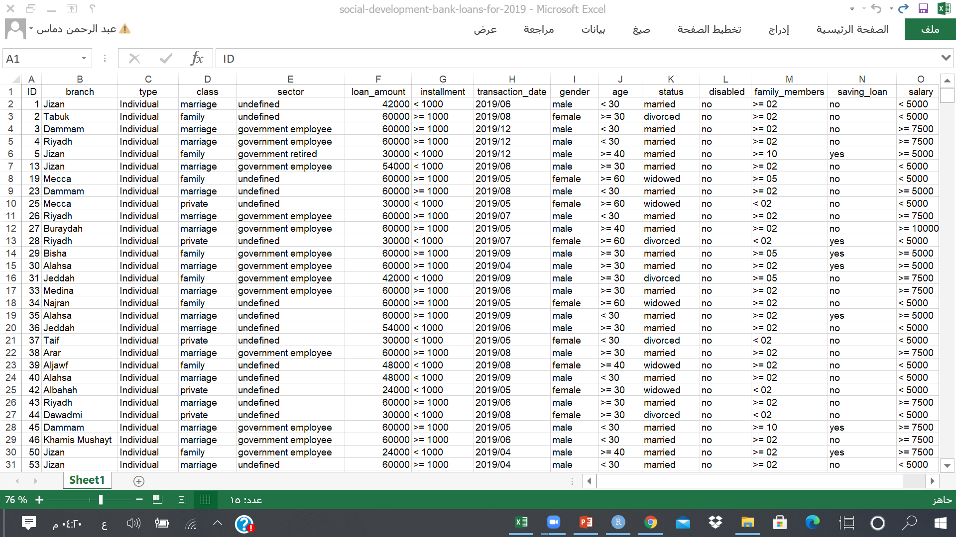
Data
Notes:
there 15 features and 85426 observation

Slide 6
Data
Categorical
Numeric
Nominal
branch
Type
Class
Sector
transaction date
status
Ordinal
Installment
age
family members
salary
Binary
Gender
Saving loan
disable
ID
Loan amount

Slide 7
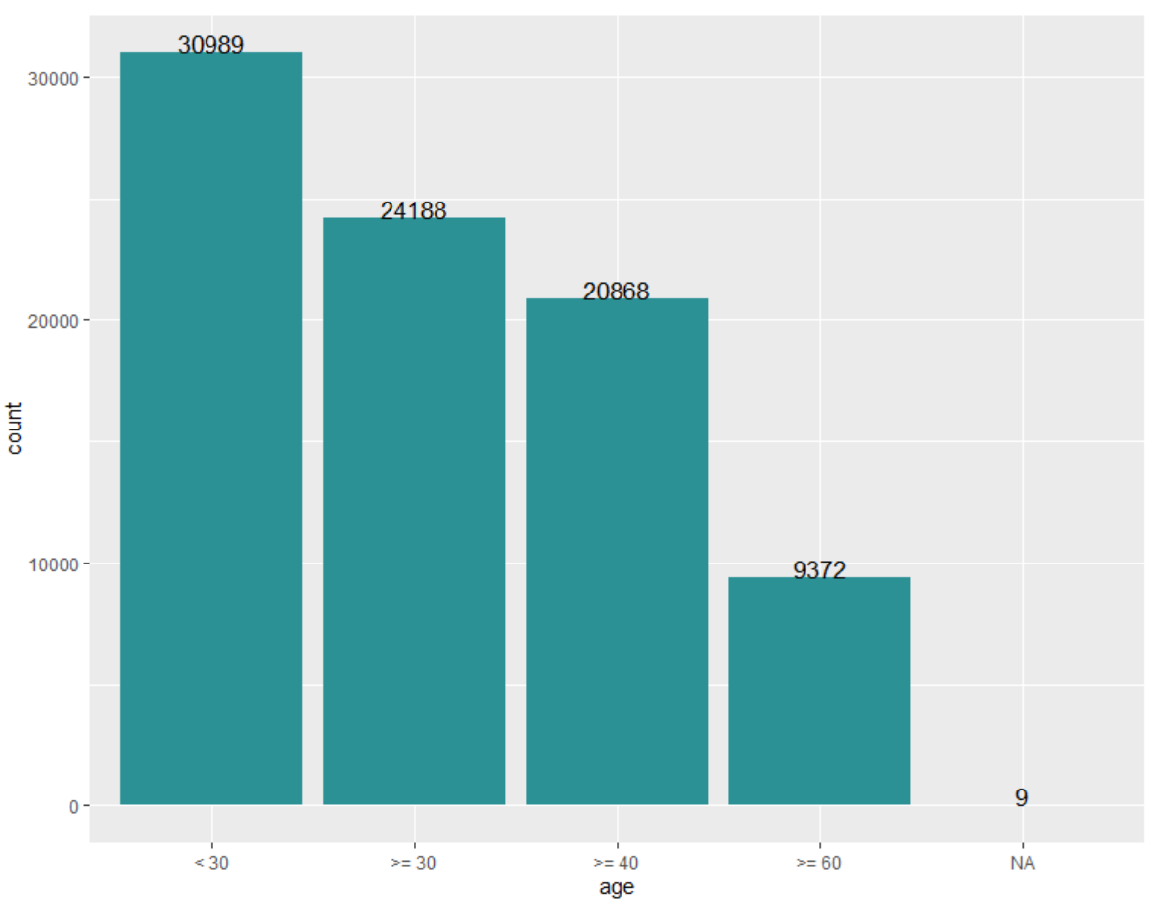
Data
There are 9 missing value in age feature

Slide 8
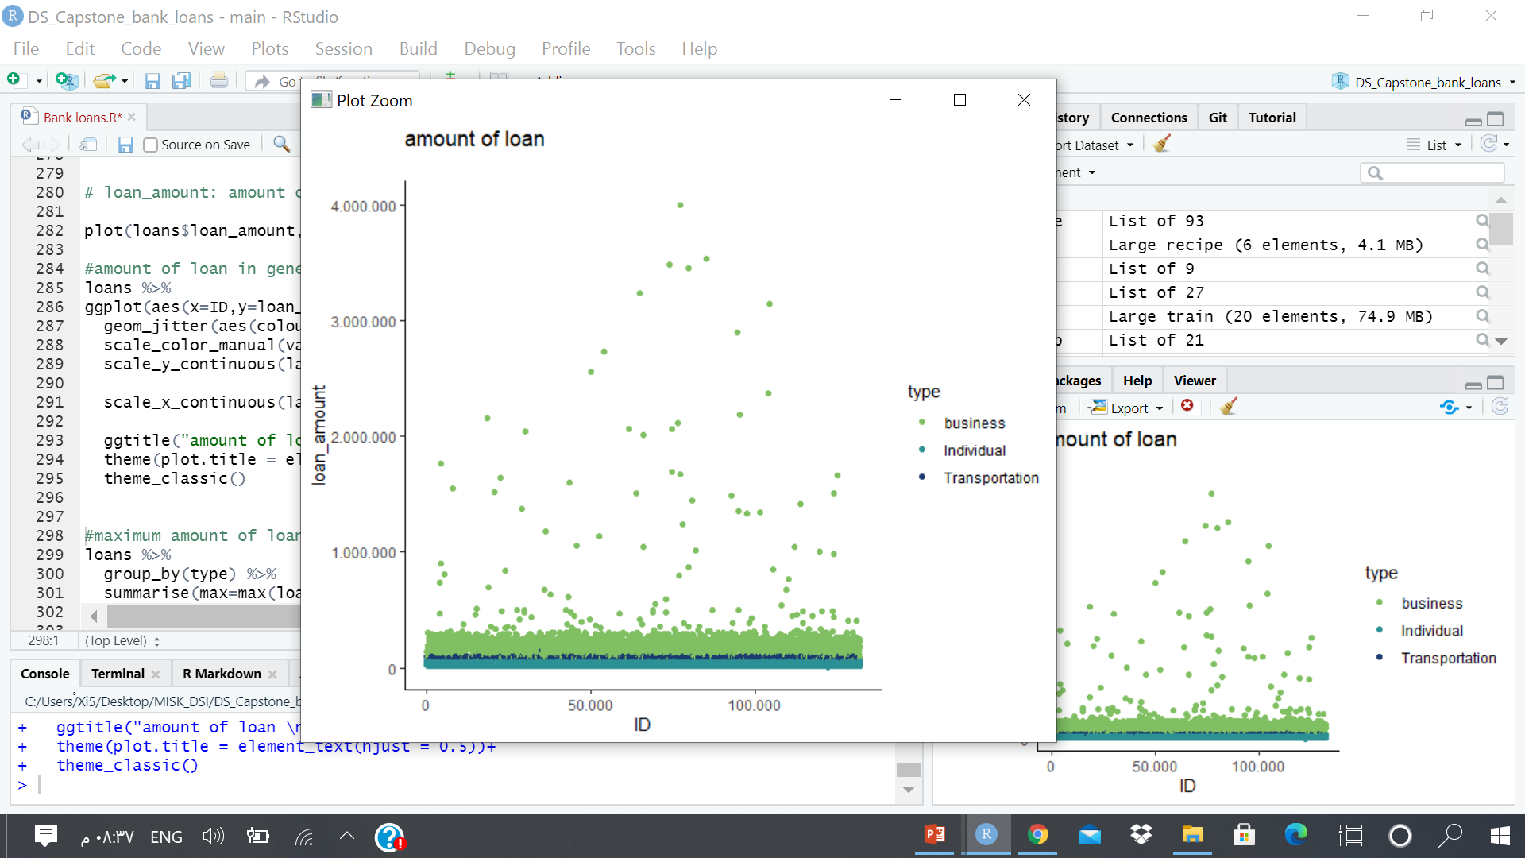
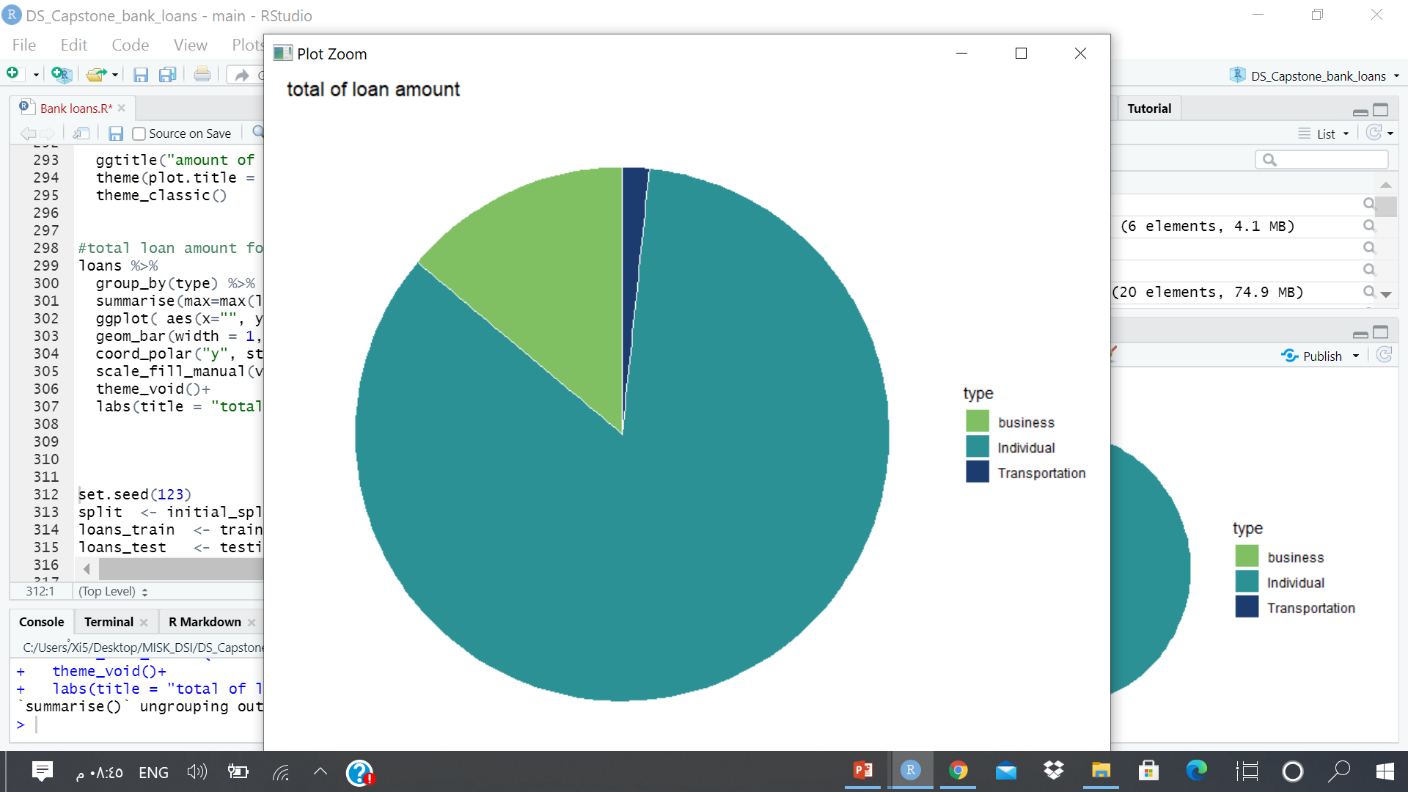
Exploratory data analysis

Slide 9
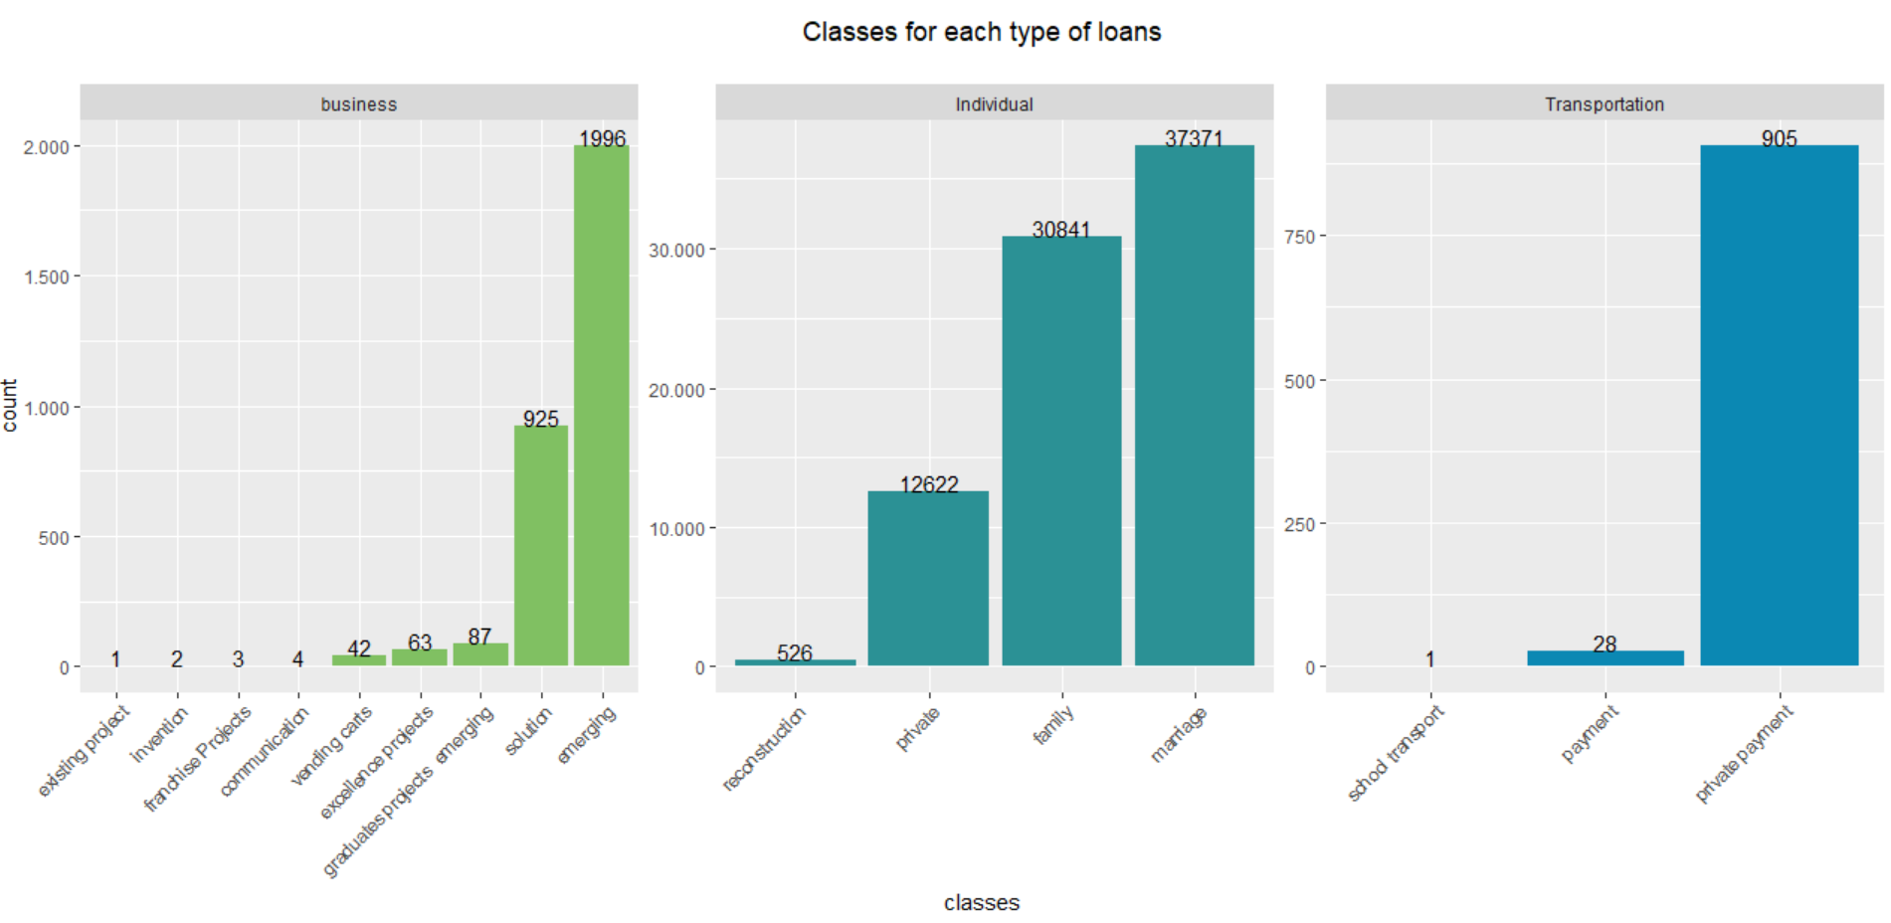
Exploratory data analysis

Slide 10
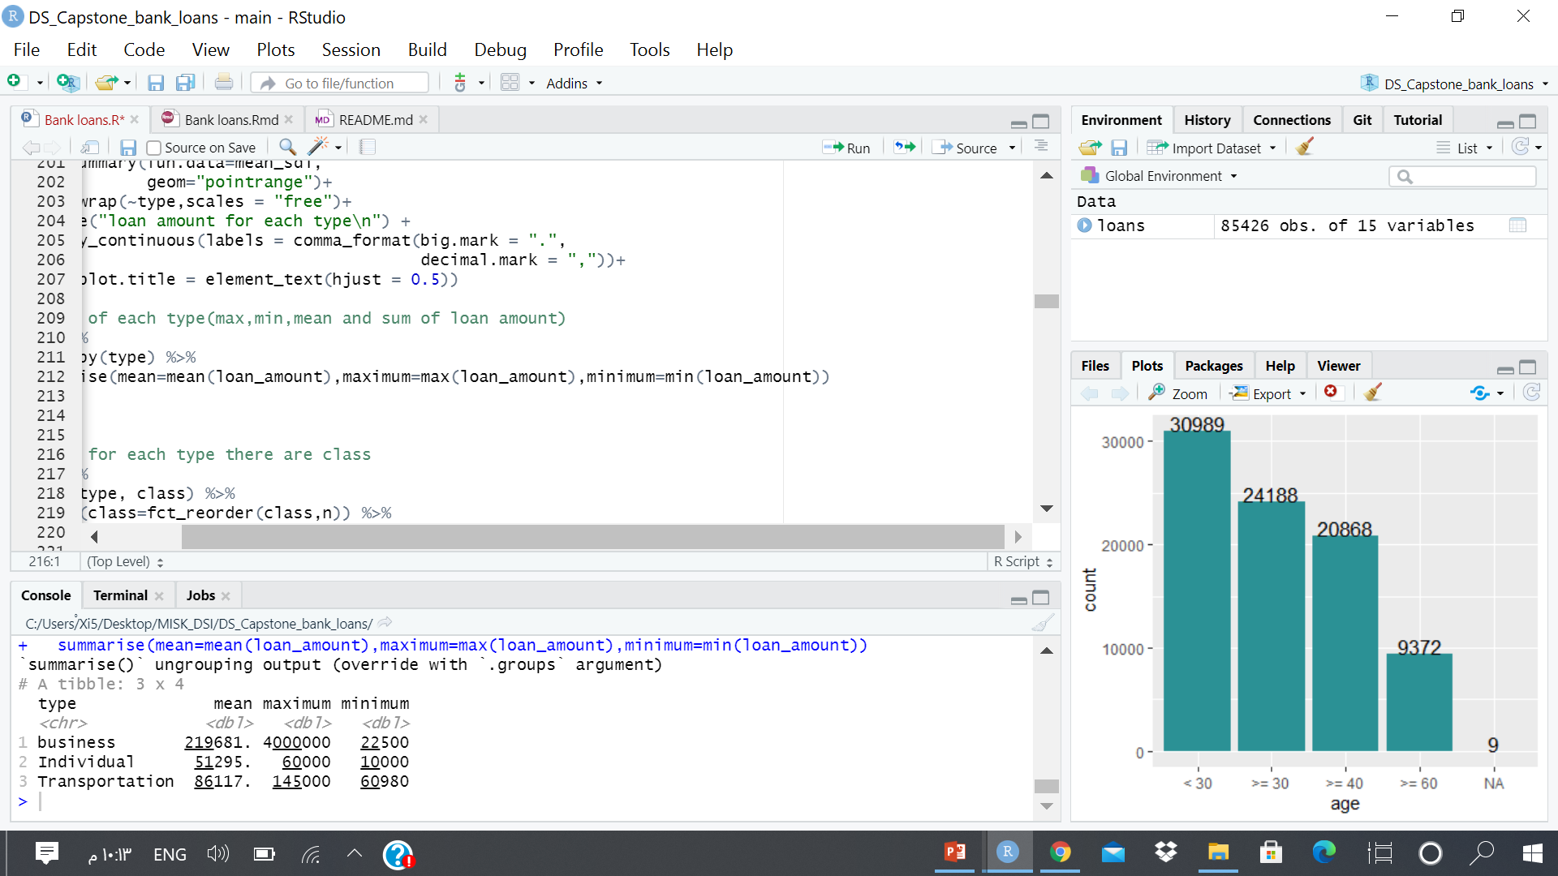
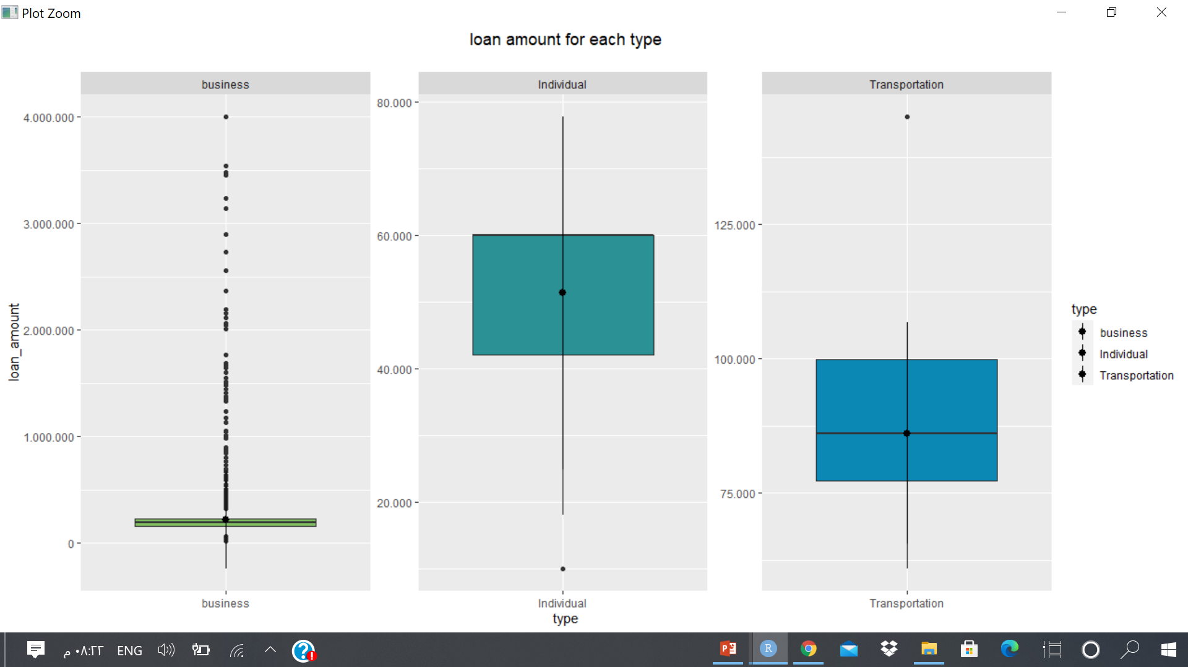
Exploratory data analysis

Slide 11
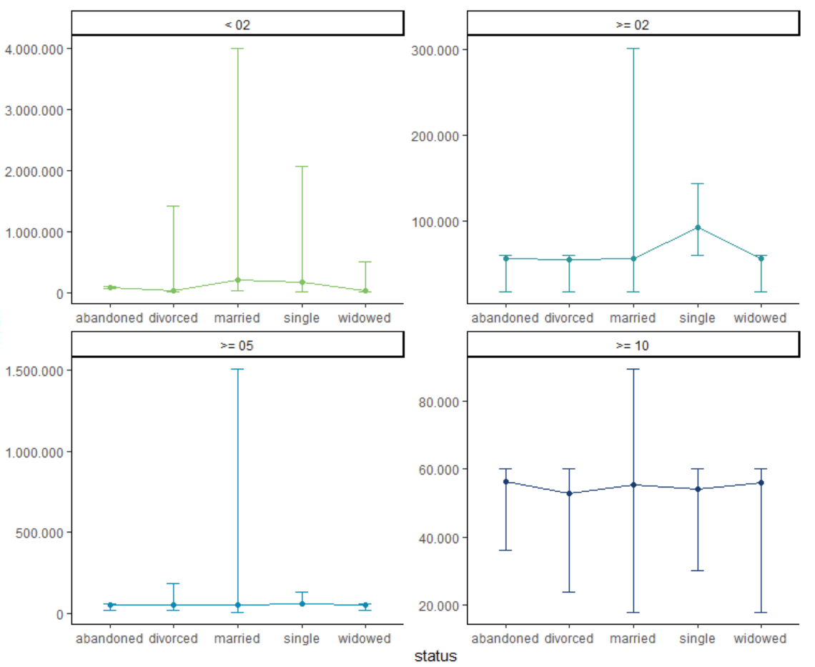
Exploratory data analysis

Slide 12
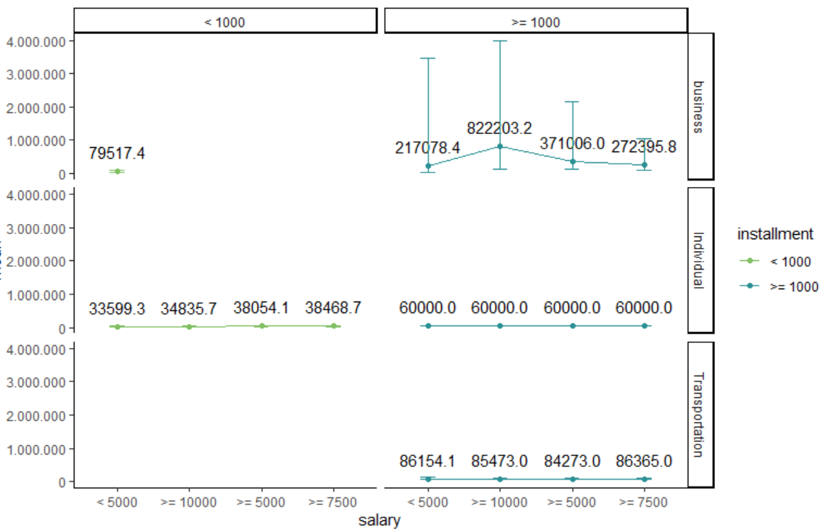
Exploratory data analysis

Slide 13
machine learning
Linear regression
K-nearest neighbours
Regularized regression
Random forest

Slide 14
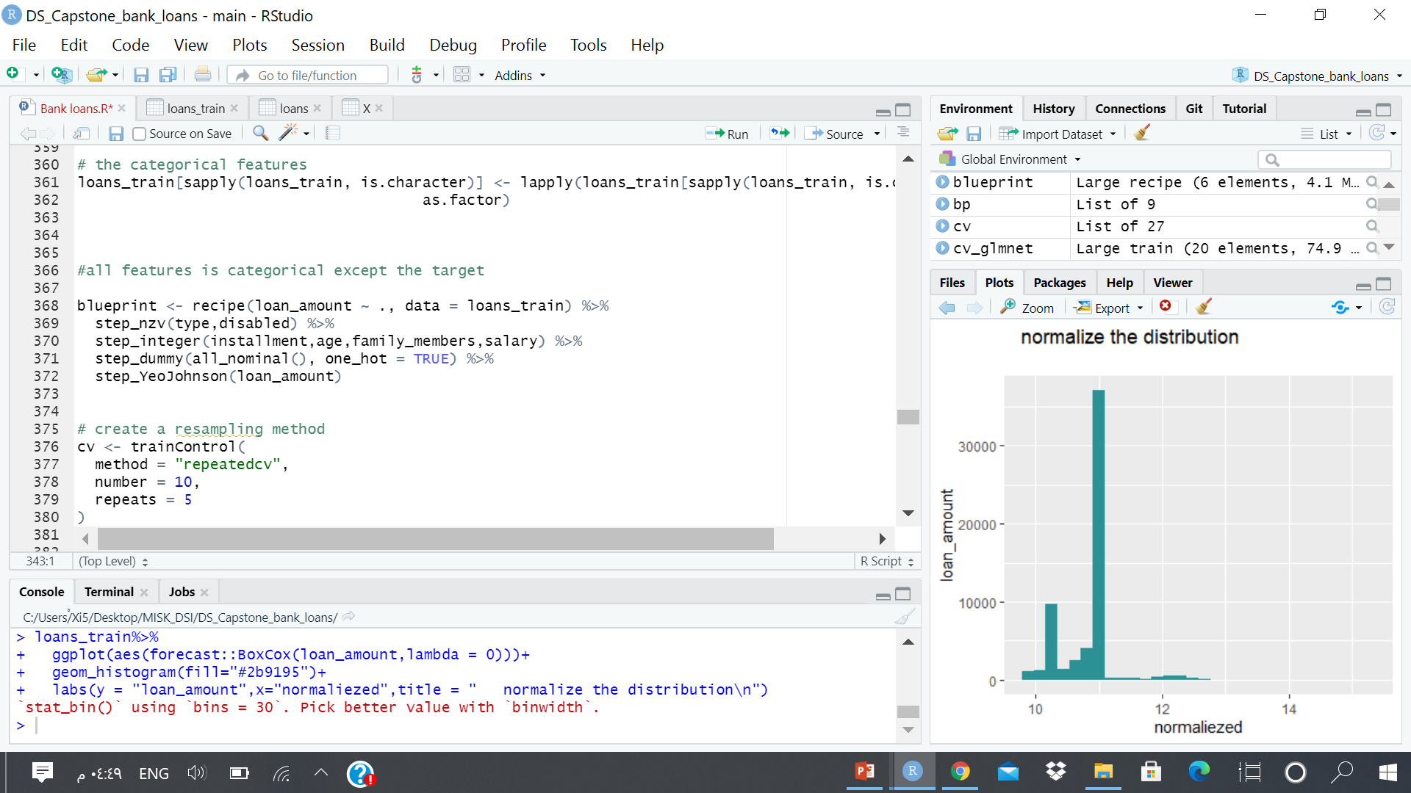
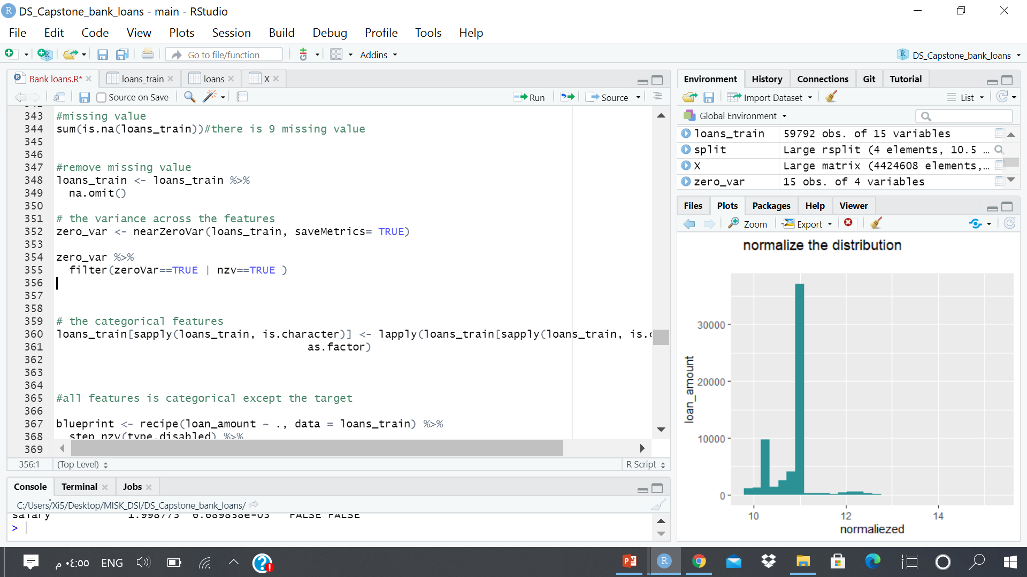
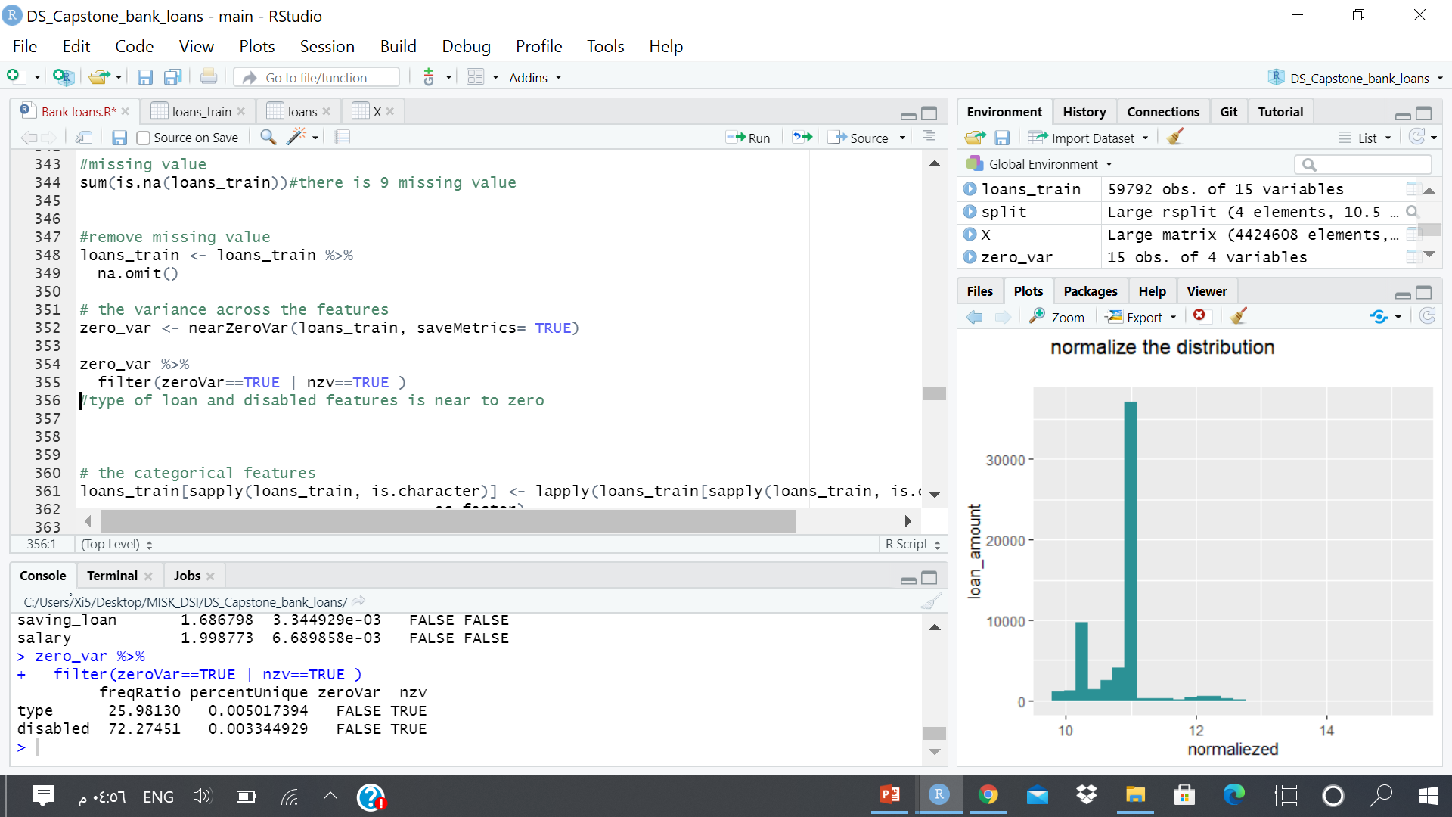
machine learning
Linear regression:
Feature engineering

Slide 15
machine learning
Linear regression
Feature engineering
installment: there tow value (less than & 1000greater than or equal 1000 )
age: there are four category (< 30, >= 30, >= 40 and >= 60 )
family members: there are four category (< 02, >= 02, >= 05 and >= 10 )
salary: there are four category (< 5000, >= 5000 ,>= 7500 and >= 10000)

Slide 16
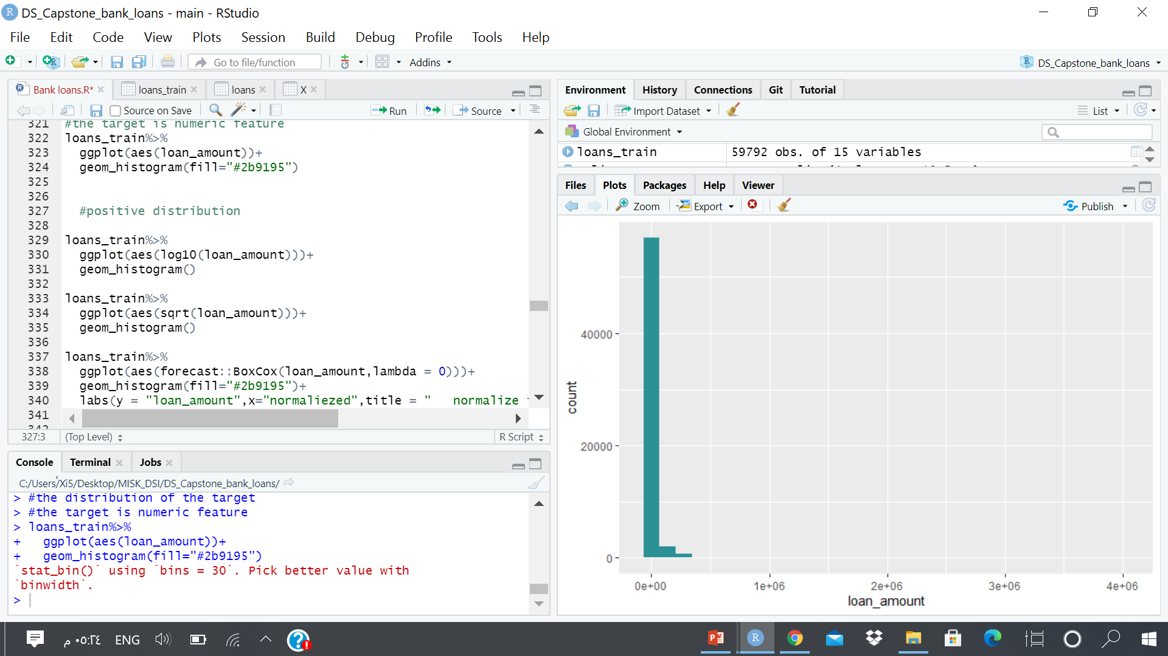
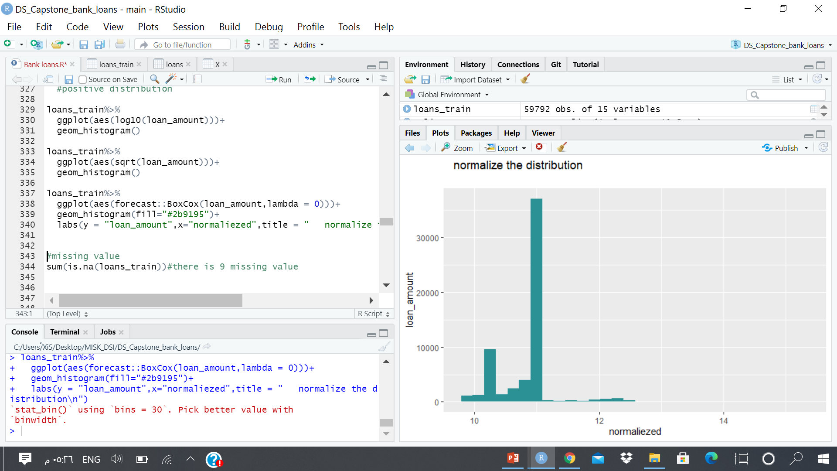
machine learning
Linear regression
Feature engineering

Slide 17
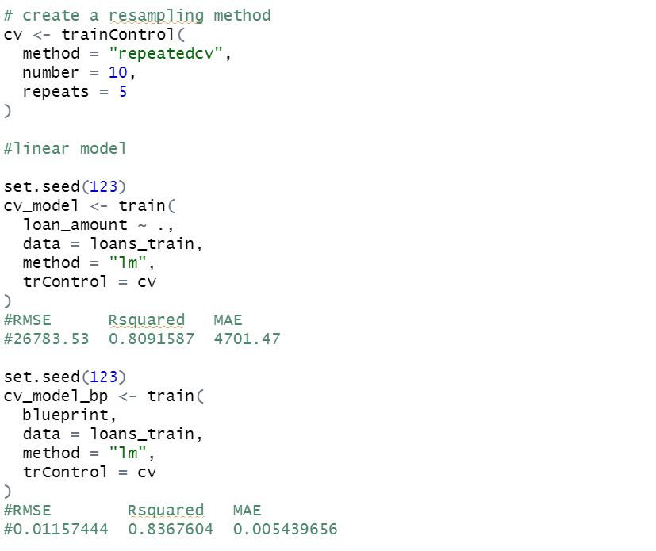
machine learning
Linear regression
With pre-processes
without pre-processes
Rsquared | RMSE
0.8367604 | 0.01157444
Rsquared | RMSE
0.891587 | 26783.53

Slide 18
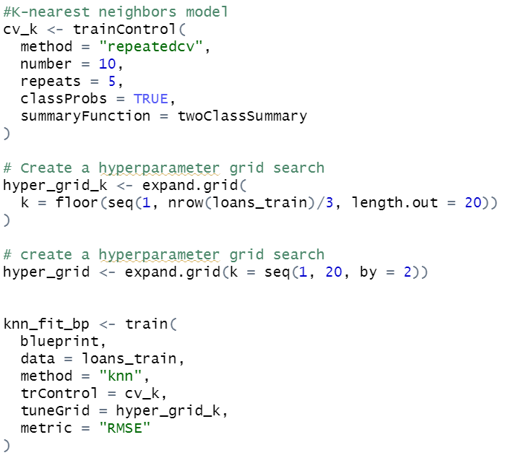
machine learning
K-nearest neighbours
k | Rsquared | RMSE
19 | 0.0205271985 | 0.9155264

Slide 19
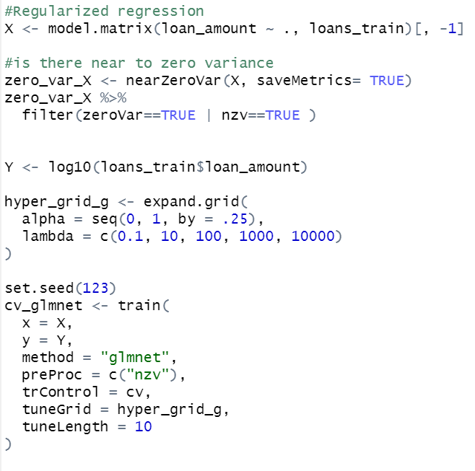
machine learning
Regularized regression
lambda | alpha | Rsquared | RMSE
0.1 | 0 | 0.6677777 | 0.1133967

Slide 20
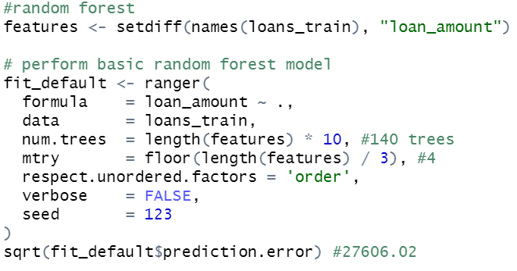
machine learning
Random forest
Type: Regression
Number of trees: 140
Sample size: 59792
Number of independent variables: 14
Mtry: 4
Target node size: 5
Variable importance mode: none
Splitrule: variance
OOB prediction error (MSE): 762092608
R squared (OOB): 0.7827091
RMSE: 27606.02

Slide 21
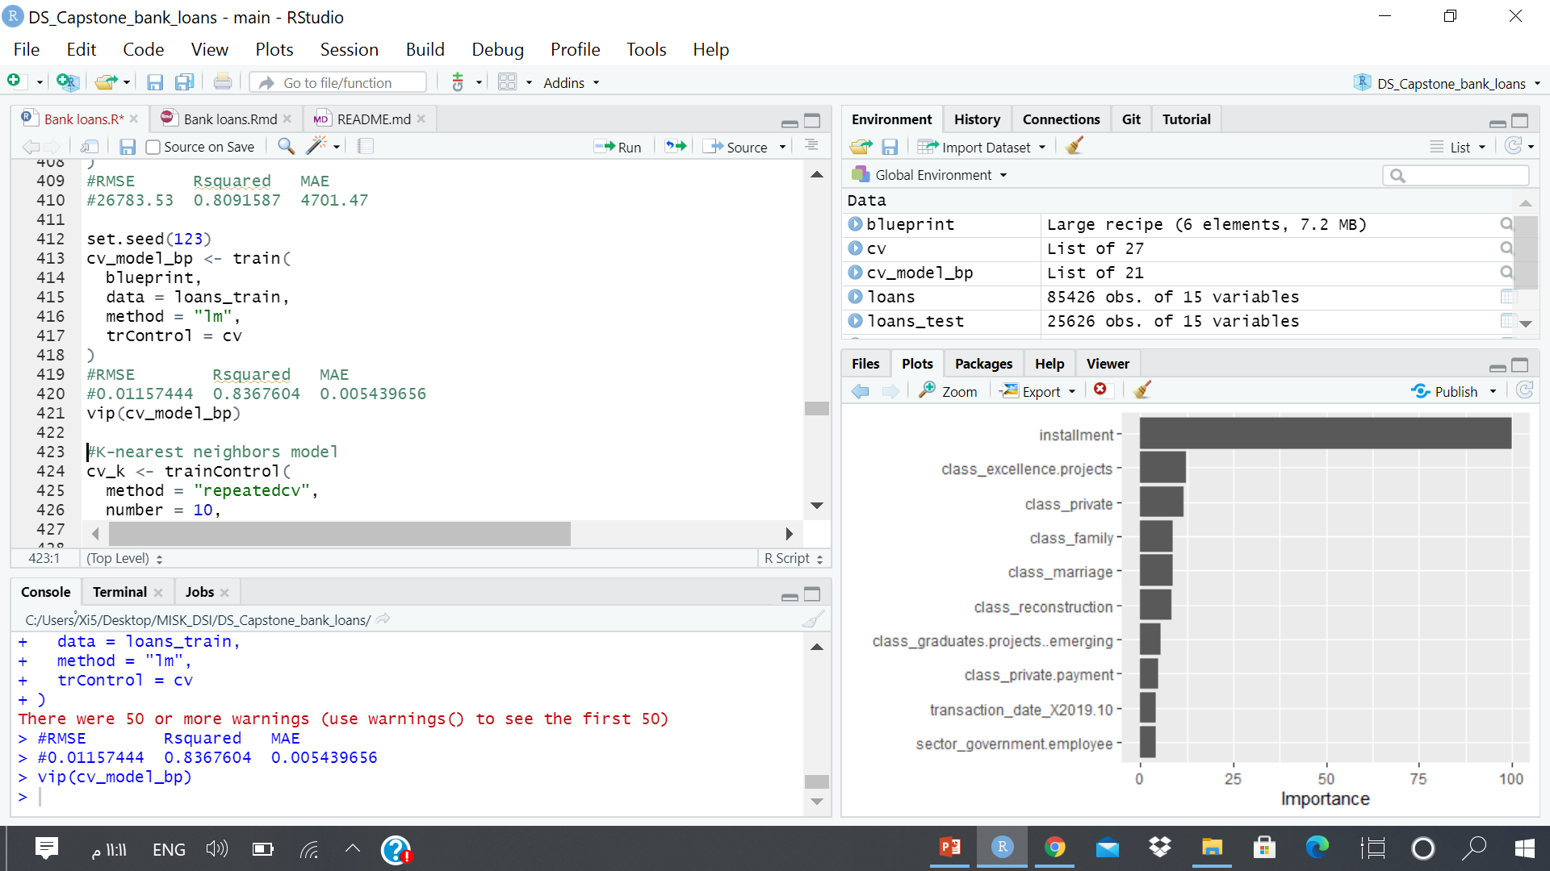
Conclusion
Linear regression is the best model that get lower RMSE and the most influential features is (installment, )
Future plan:
Improve random forest model
analysis same data with other version(2015 - 2020)

